Slide 1
BlueStone Realty Inc.
Business Intelligence Analysis
on House Prices
Non-Technical Presentation
Springboard Data Analytics
Capstone - 2
Date : 7/18/2020
Presented By : Huseyin Korkmaz

Slide 2
The yearly actual revenue is $4M less than the budget revenue as of July 2010. It is necessary to increase the revenue by at least 16% with respect to the budget of $25M until the end of the year. Remodeling houses before selling them can be an effective strategy to have more revenue opportunities.
!
While June and July are the months in which most houses are sold, this period of 2010 is `the worst June and July ever' for BlueStone. Despite the monthly sale price is $10.8M in June 2009, it is $6.5M in June 2010. As of July 2010, BlueStone's actual revenue is $4M behind budget revenue.
Actual revenue is $4M behind the budget revenue
!
In order to catch the revenue of 2009, BlueStone should reach the target of $29M revenue in the remaining 5 months of the year by increasing its $25M budget revenue by at least 16%.
To increase the revenue by at least 16% is necessary
!
The sooner the remodeling the higher the value of the house. Actions should be taken to have more revenue opportunities by determining the top houses which are expected to provide the most revenue opportunities in the case of the remodeling them.
Remodeling houses can be
an effective business strategy

Slide 3
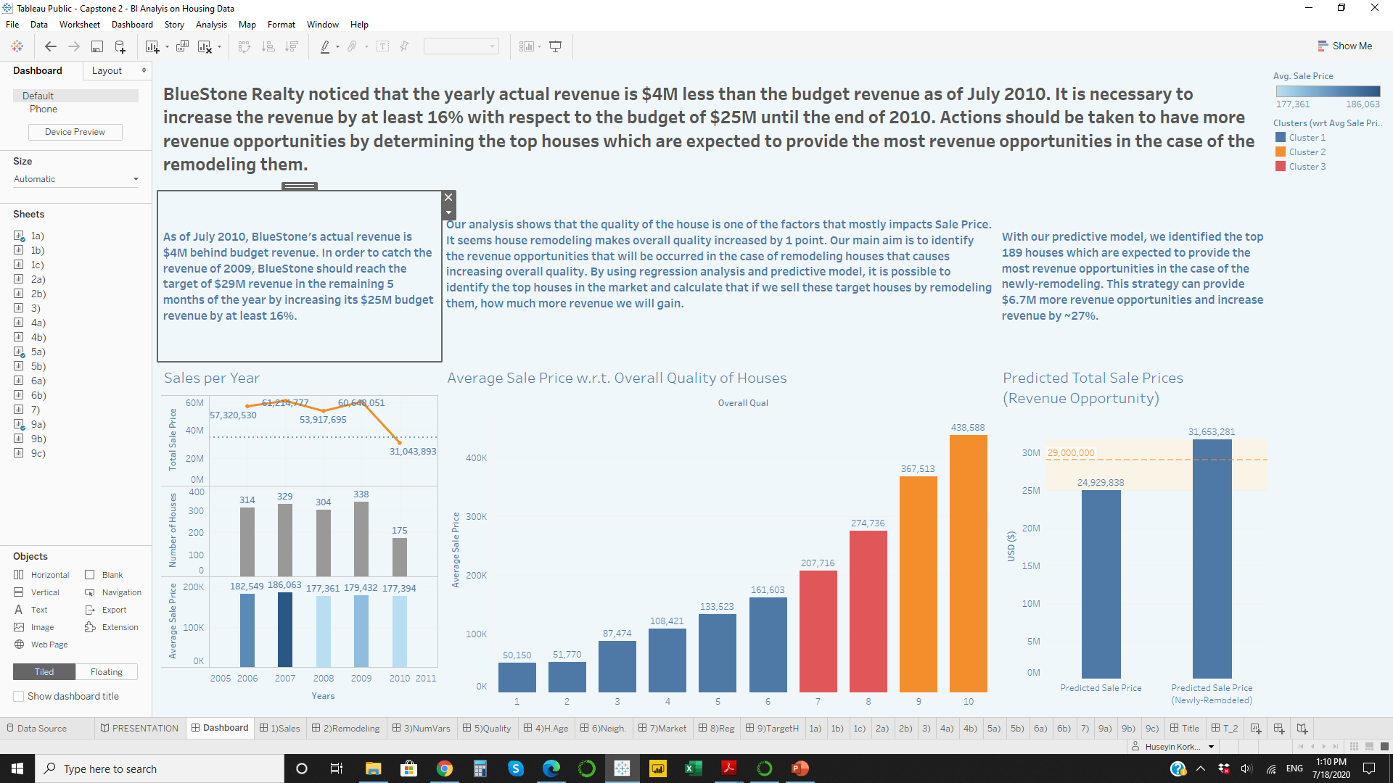
While June and July are the months in which most houses are sold and most revenues are gained, as of June 2010, BlueStone Realty's revenue started severely decreasing. To remodel houses before the sale can provide more than $29M in revenue in the remaining 5 months of the year.
Key Insights
Decreasing Revenue – The yearly actual revenue is $4M less than the budget revenue as of July 2010. In order to catch the revenue of 2009, BlueStone should reach the target of $29M revenue in the remaining 5 months of the year by increasing its $25M budget revenue by at least 16%.
Revenue Opportunity – With our predictive model, we identified the top 189 houses which are expected to provide the most revenue opportunities in the case of the newly-remodeling. This strategy can provide $6.7M more revenue opportunities and increase revenue by ~27%.
Source: Ames, Iowa Housing Data (Kaggle)

Slide 4
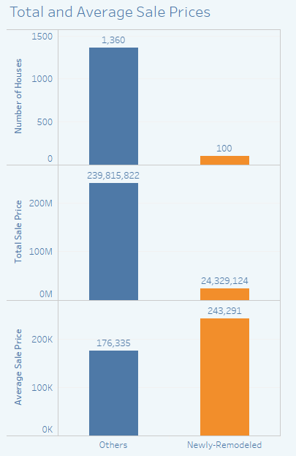
Remodeling Houses
Our analysis on the sold houses shows that the sooner the remodeling the higher the value of the house. As a business strategy, remodeling houses before selling them can be an effective solution to receive more revenue opportunities.
What does it mean
Newly-Remodeled House?
If a house was remodeled one year or less time before it was sold, it shows this house was remodeled for sale. We will call these houses Newly-Remodeled.
We will call other houses as Others or Non-Newly-Remodeled which weren't remodeled or were remodeled more than one year before sales.
There are 100 newly-remodeled and 1360 non-newly-remodeled sold houses.
The average sale price of newly-remodeled houses is 243K$. The average sale price of non-newly-remodeled houses is 176K$. It looks 67K$ difference between the average sale price of newly-remodeled houses and others'.
Source: Ames, Iowa Housing Data (Kaggle)

Slide 5
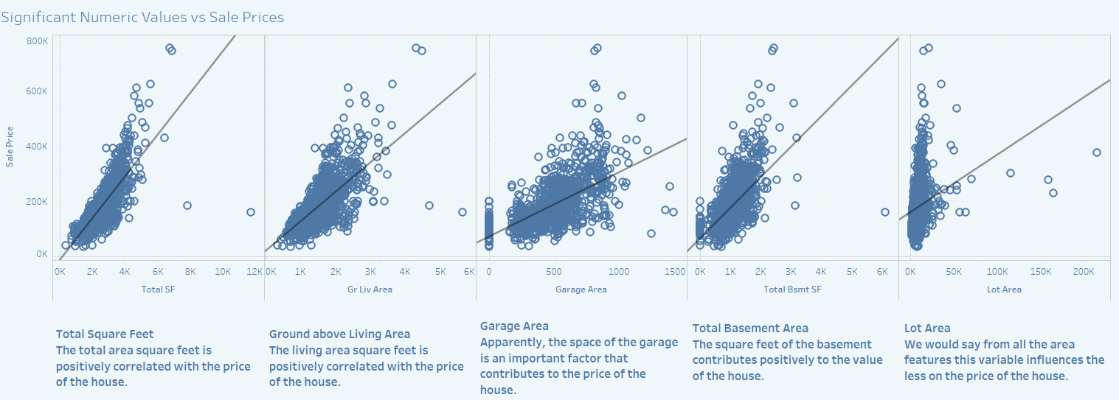
The Influence of Space
Overall Quality, Total Area, Ground above Living Area, Garage Area, Total Basement Area, and Lot Size are the top variables that have a strong relationship with Sale Price.
Source: Ames, Iowa Housing Data (Kaggle)

Slide 6
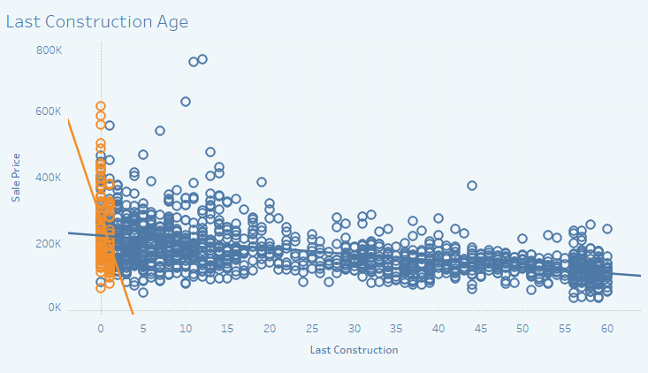
Last Construction Age
Houses in the high price range were remodeled sooner. The sooner the remodelation the higher the value of the house.
It seems remodeling houses before selling them can increase sale prices.
This insight supports our hypothesis of the effect of newly-remodeling on the sale price.
Source: Ames, Iowa Housing Data (Kaggle)

Slide 7
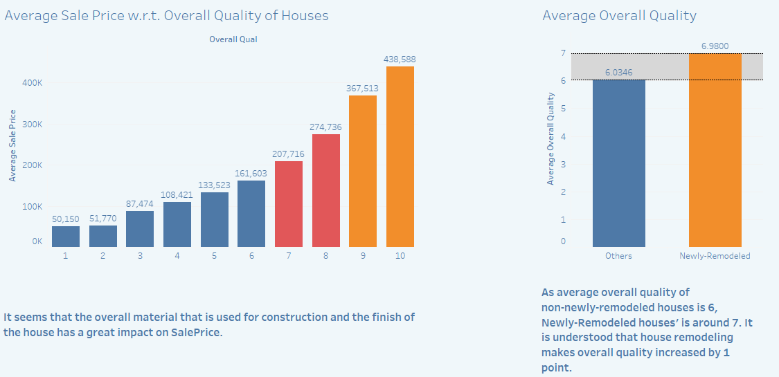
Overall Quality
Our analysis shows that the quality of the house is one of the factors that mostly impacts Sale Price. It seems house remodeling makes overall quality increased by 1 point. Moving the quality of a house to the next level by remodeling it can increase its Sale Price.
Source: Ames, Iowa Housing Data (Kaggle)

Slide 8
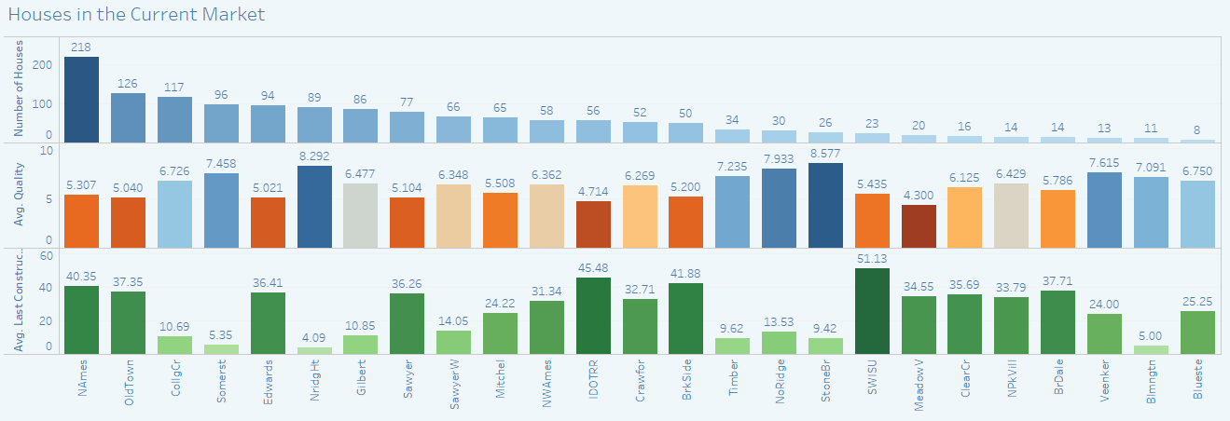
Current Market
There are 1459 houses in the current market. 218 of them with 5.3 average quality are based in North Ames. Stone Brook has highest overall quality rate with 8.5.
Source: Ames, Iowa Housing Data (Kaggle)

Slide 9
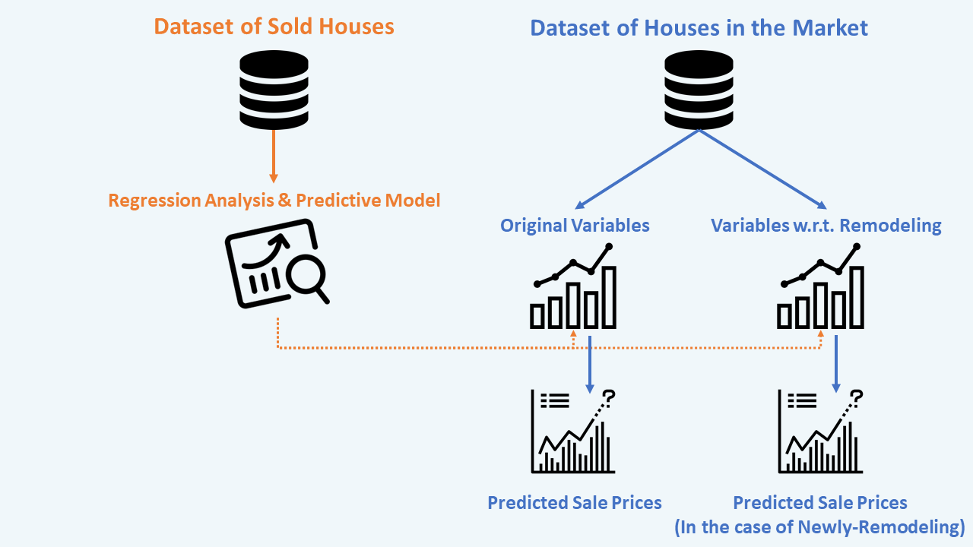
Business Intelligence Analysis
By using regression analysis and predictive model, it is possible to identify the top houses in the market and calculate that if we sell these target houses by remodeling them, how much more revenue we will gain.
To see the sale price difference in the case of remodeling, we copied dataset of houses in the market, then modified one of them by assuming the houses were newly remodeled in 2010 and their overall quality moved to the next level. Thus we were able to compare the predicted sale prices of newly-remodeled houses and non-newly-remodeled houses.
Source: Ames, Iowa Housing Data (Kaggle)

Slide 10
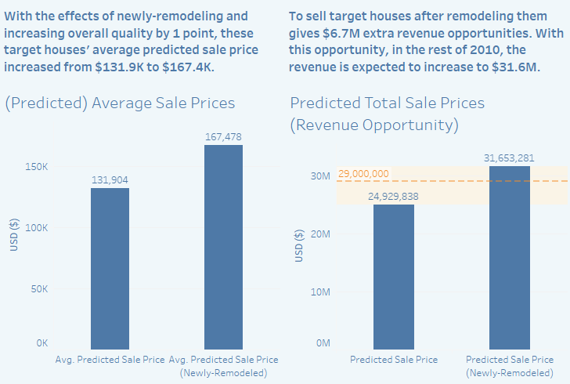
Revenue Opportunity
With our model, we identified the top 189 houses which are expected to provide the most revenue opportunities in the case of the newly-remodeling. This strategy can provide $6.7M more revenue opportunities and increase revenue by ~27%.
BlueStone Realty wanted to have a strategy to increase revenues by at least 16% until the end of the year. After our market analysis, house remodeling strategy, regression analysis, house price predictions, and business intelligence analysis, we achieved a strategic solution that can provide increased revenue by ~27%.
Source: Ames, Iowa Housing Data (Kaggle)

